Slide 1
Cyber Attacks & Defense
Arbitrary Read/Write
Yeongjin Jang

Slide 2
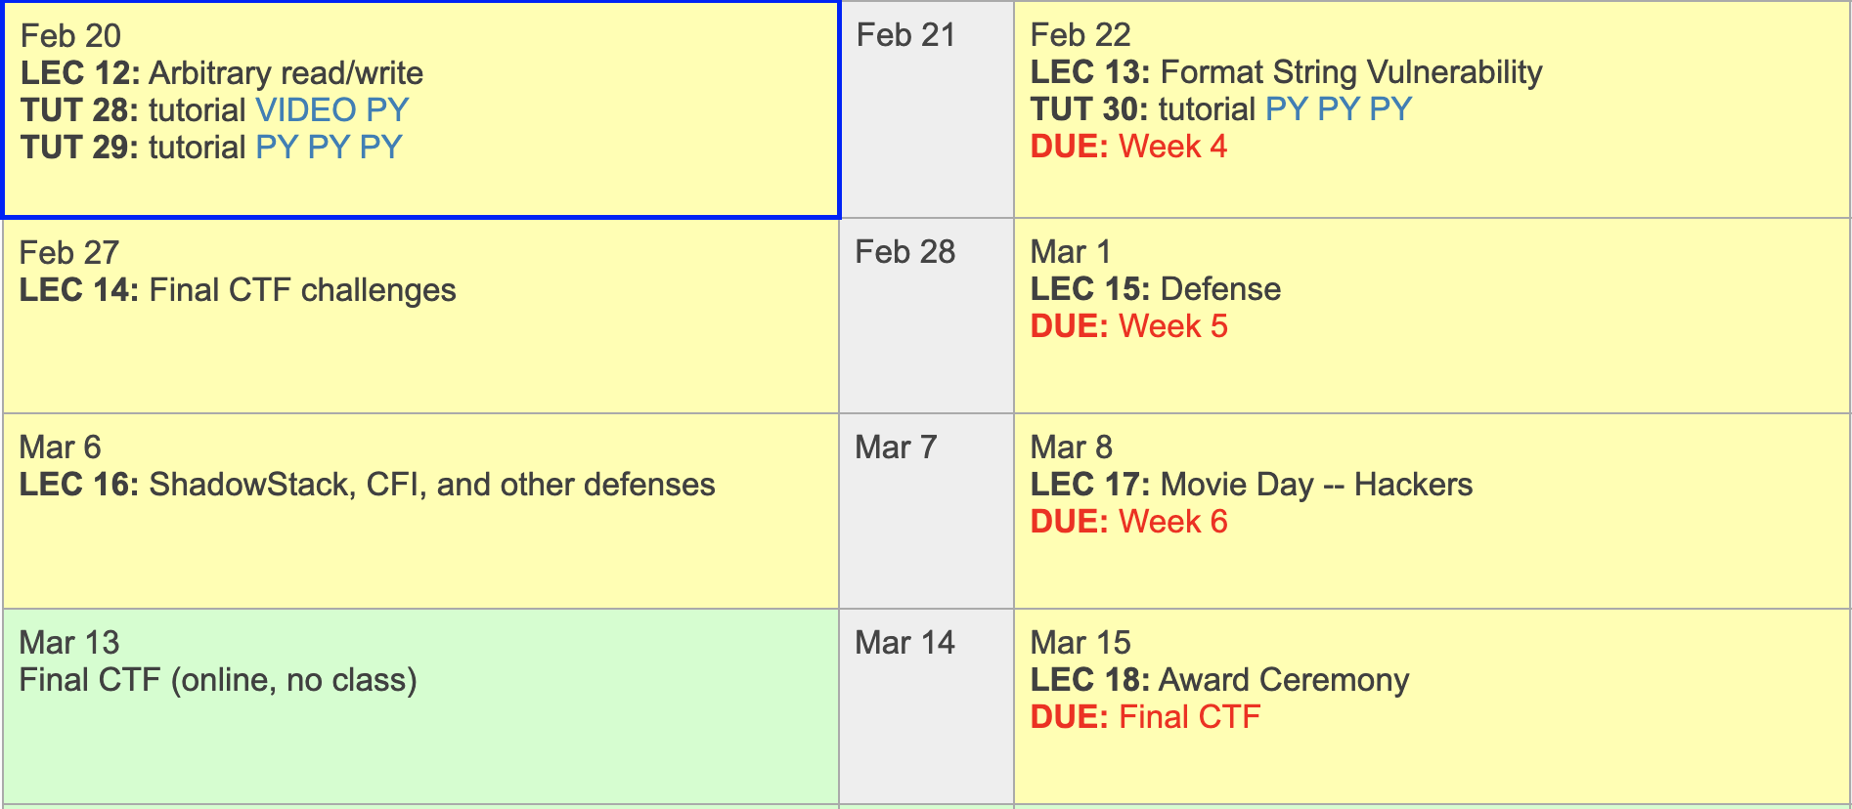
Schedules

Slide 3
Final CTF
15+ challenges
All extra credits
Awards for 1st, 2nd, and 3rd place
  Prizes are scrambled

Slide 4
Buffer Overflow and
Control-flow Hijacking
Buffer overflow: fill the buffer more than its size
  Overwriting return address (saved %eip)
  Overwriting frame pointer (saved %ebp)
Control-flow Hijacking
  Return to some other functions
  Return to shellcode
  Return to ROP gadgets
shellcode
RETURN ADDR
DDDD
SAVED %ebp
COOKIE
CCCC
BUFFER
BBBB
BUFFER
AAAA
BUFFER

Slide 5
Control-flow Hijacking
Control-flow Hijacking
  Return/jump/call to some other functions
  Return/jump/call to shellcode
  Return/jump/call to ROP gadgets
Attack targets
  Return address
  Global offset table (GOT)
  Function pointer
  Jump table

Slide 6
ELF, PLT, GOT
PLT
printf()
strcpy()
The program
Calls a function
In PLT
read()
PLT jumps to GOT
Program
printf()
Libc
printf()
…
strcpy()
…
read()
…
_dl_dynamic_resolve
GOT
7fa174b06800
_resolve
_resolve
_resolve
GOT stores addr of _dl_dynamic_resolve

Slide 7
What is the Requirement for CFH?
Is buffer overflow the only way to achieve control-flow hijacking?
  Overwriting return address (saved %eip)
  Overwriting frame pointer (saved %ebp)
What we need is the capability to write on certain addr
  Arbitrary write!
Today we will learn arbitrary read/write
RETURN ADDR
RETURN ADDR
SAVED %ebp
SAVED %ebp
COOKIE
BUFFER
BUFFER
BUFFER

Slide 8
Attack Primitives
Arbitrary Read
  Read from any address A, any number N of bytes
  The attacker must know the address A
Example:
  Read 100 bytes from 0xffffd100 (somewhere in the stack)
  Read 100 bytes from 0x8048500 (somewhere in the code section)
Can this break:
  Stack-Cookie?
  ASLR?
  DEP?

Slide 9
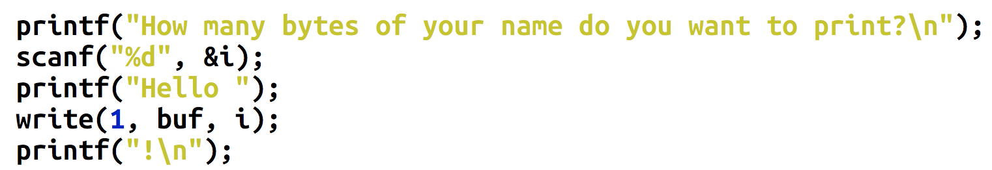
Breaking Stack-Cookie
The cookie value is on the stack
Sequential read can break stack-cookie easily
RETURN ADDR
SAVED %ebp
COOKIE
BUFFER
BUFFER
BUFFER

Slide 10
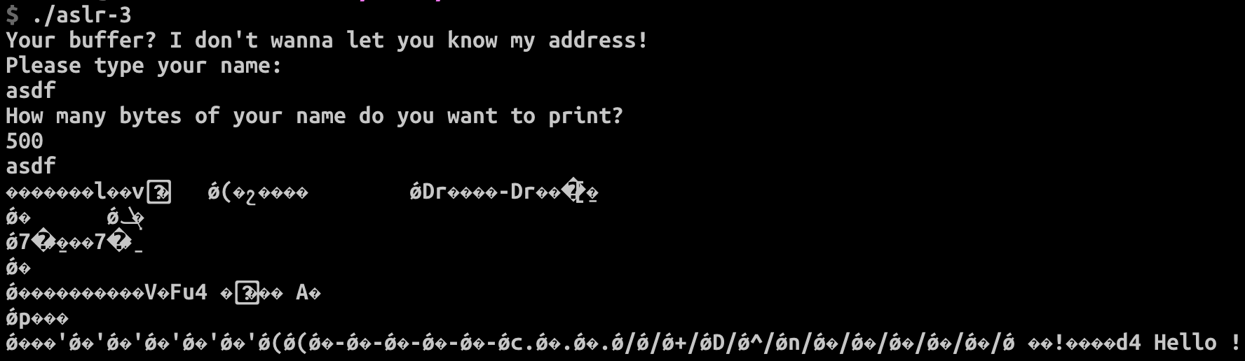
Example of Sequential Read
ASLR-3
  Leak addresses via sequential leaks from one point of the stack
  We do not know ‘A’, but can specify ‘N’
  Sometimes this is more powerful than arbitrary read

Slide 11
Breaking Stack-Cookie
The cookie value is on the stack
Arbitrary Read
  Read where?
  The address that the cookie is stored!
Then launch buffer overflow attack
You should know the address of the stack..
RETURN ADDR
SAVED %ebp
COOKIE
BUFFER
BUFFER
BUFFER

Slide 12
Breaking ASLR
Arbitrary Read
  Read anywhere if you know the address…
Read where?
  Non-PIE: Code section is fixed 0x8048000 ~ 0x804a000
    0x401000 ~ and 0x601000 in 64 bit
  Stack – random
  Library – random
  Heap – random
Code/data sections are the only fixed locations

Slide 13
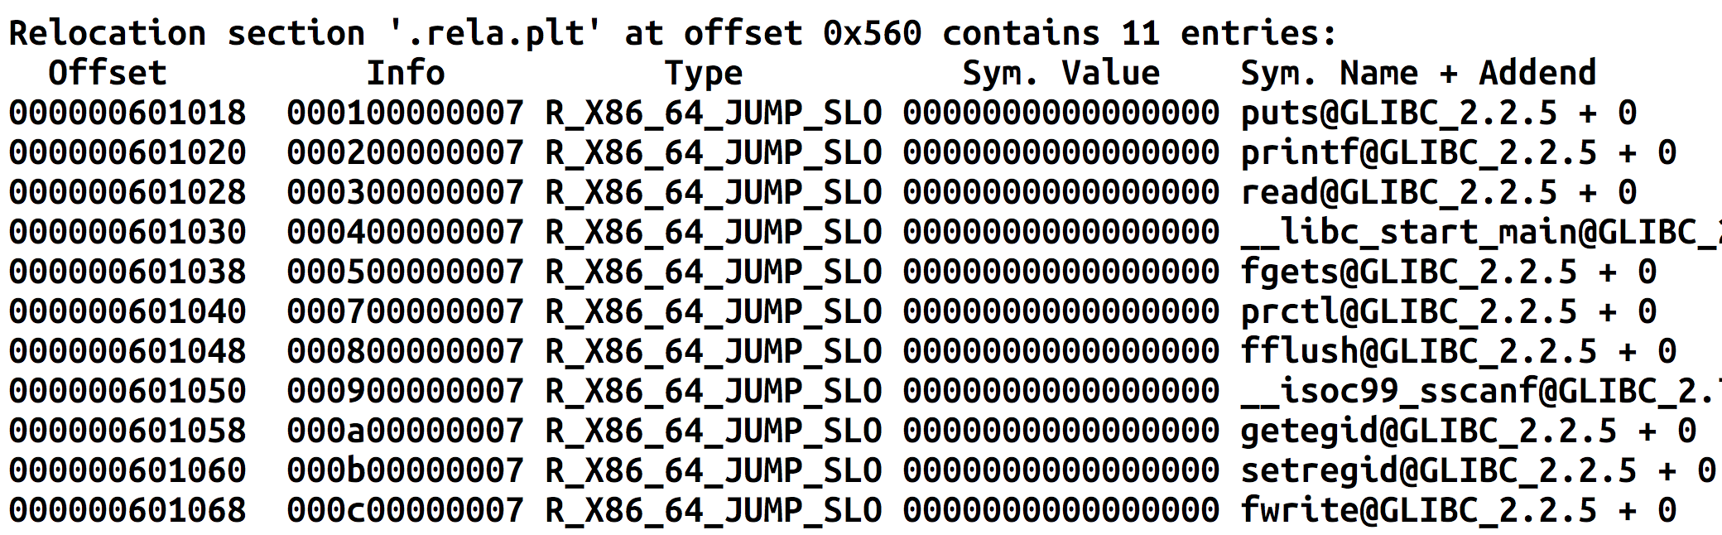
Breaking ASLR + DEP
GOT stores address of libc functions
  printf, puts, read, etc.

Slide 14
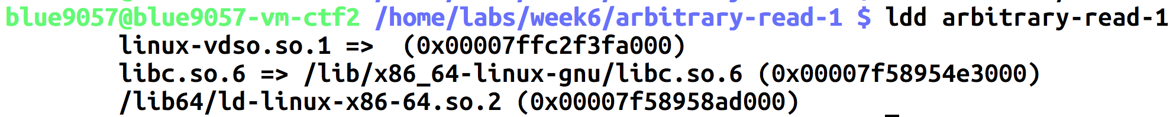
Breaking ASLR + DEP
Read a value from GOT
  Can get the address of puts()
Can you calculate the address of execve() or system() from puts?
Yes
  Load libc and find offsets, diff, and calculate

Slide 15
Challenges – Week6
sr-1
  The program will perform a sequential read from the stack for you
  Read addresses from the leak and exploit the vulnerability!
  All protection enabled: ASLR + DEP + Stack-cookie + PIE
  Steps: break stack cookie first, then kill ASLR on libc, call execv!
ar-2
  You may perform arbitrary read
    Can specify where to read and how many bytes to read
  Read GOT of some functions to get the address of that function in libc
  Call system, execve, whatever you want!

Slide 16
Attack Primitives
Arbitrary Write
  Write on any address, any number of bytes
  The attacker must know the address
Example:
  Write 100 bytes of data to 0xffffd100 (somewhere in the stack)
  Write 100 bytes of data to 0x8048500 (somewhere in the code section)
Can achieve control-flow hijacking
  Overwrite return address
  Overwrite frame pointer
  Overwriting GOT

Slide 17
Attacking Global Offset Table
Read the address in GOT
Leak the address of printf()
Calculate the address of system() from the offset
Write that address system() to printf’s GOT
What will happen a program calls printf?

Slide 18
ELF, PLT, GOT
PLT
printf()
strcpy()
The program
Calls a function
In PLT
read()
PLT jumps to GOT
Program
printf()
Libc
printf()
…
strcpy()
…
read()
…
GOT
libc_printf
libc_strcpy
libc_read
GOT stores libc addr

Slide 19
ELF, PLT, GOT
PLT
printf()
strcpy()
The program
Calls a function
In PLT
read()
PLT jumps to GOT
Program
printf()
Libc
printf()
…
strcpy()
…
read()
…
GOT
libc_SYSTEM
libc_printf
libc_strcpy
libc_read
GOT stores libc addr

Slide 20
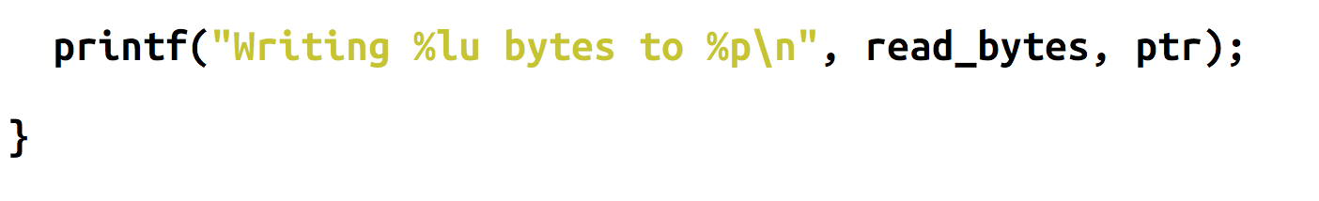
Attacks with Arbitrary Write
GOT address is known for non-PIE
Choose one function that is called in the program
Overwrite the GOT of printf to system()
  What will happen?
  system(“Writing %lu bytes to %p\n”) -> fails…

Slide 21
Arbitrary-Write-1
Change the GOT of printf to to ‘please_execute_me()’ via arbitrary write capability!
Printf after the buffer overflow vulnerability will run that function for you.

Slide 22
Arbitrary-Write-2
Program contains both arbitrary-read and arbitrary-write vulnerability.
Exploit arbitrary read to get the address of libc function
  Then calculate the address of system()
Exploit arbitrary write to overwrite the GOT of printf to system()
  printf("Writing %lu bytes to %p\n”);
  system(“Writing %lu bytes to %p\n”);

Slide 23
Assignment: Week-6
  Please solve challenges in the /home/labs/week6 directory
  Hosted in vm-ctf2
Due: 03/08 11:59pm

